Slide 1
FUNDAMENTAL PROBLEMS AND
ALGORITHMS
Branch and Bound
© Giovanni De Micheli
Stanford University

Slide 2
Branch and bound algorithm for covering
Reduction strategies
Partitioning:
  If A is block diagonal:
    Solve covering problem for corresponding blocks.
Essentials:
  Column incident to one (or more) row with single 1:
    Select column.
    Remove covered row(s) from table.
Discuss the historic example of essential subset and function core

Slide 3
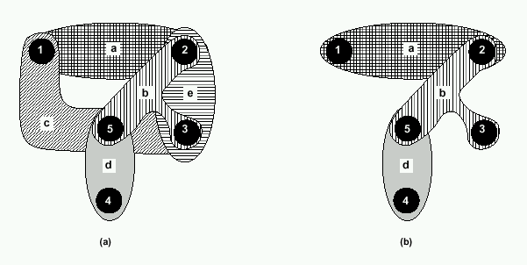
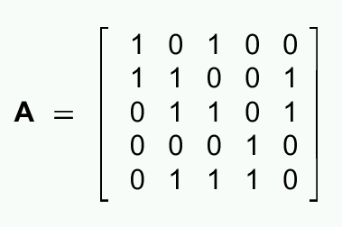
Example
a b c d e
I want to cover rows by columns
1 2 3 4 5
Explain row and column domination

Slide 4
Branch and bound algorithm for covering. Reduction strategies
Column dominance:
  If a_{ki} ≥ a_{kj} ∀k:
    remove column j .
Row dominance:
  If a_{ik} ≥ a_{jk} ∀k:
    Remove row i .

Slide 5
Example reduction
Fourth column is essential.
Fifth column is dominated.
Fifth row is dominant.
1 0 1
1 1 0
0 1 1
a b c d e
A =
1 2 3 4 5

Slide 6
Branch and bound covering algorithm
EXACT COVER( A; x; b) {
Reduce matrix A and update corresponding x;
if (Current est i mate j bj ) return(b);
if ( A has no rows ) return (x);
Select a branching column c;
xc =1 ;
A = A after deleting c and rows incident to it;
x =EXACT COVER(A; x; b);
if ( j xj < j bj )
b = x ;
xc =0 ;
A = A after deleting c ;
x =EXACT COVER(A; x; b);
if ( j) xj <j bj )
b = x ;
return (b);
}

Slide 7
Bounding function
Estimate lower bound on the covers derived from the current x.
The sum of the ones in x, plus bound on cover for local A:
  Independent set of rows:
    No 1 in same column.
  Build graph denoting pair-wise independence.
  Find clique number.
  Approximation by defect is acceptable.

Slide 8
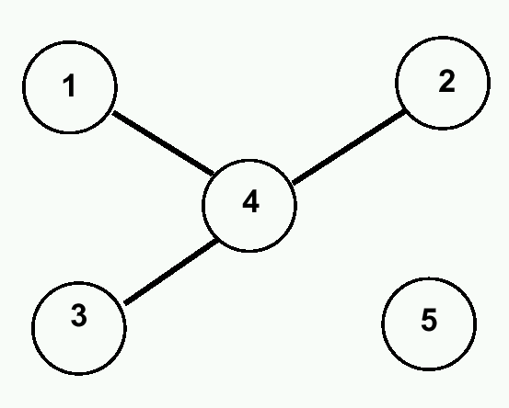
Example
1 01 00
1 10 01
0 11 01
0 00 10
0 11 10
A =
clique
independent
Row 4 independent from 1,2,3.
Clique number is 2.
Bound is 2.

Slide 9
Example
1 0 1
1 1 0
0 1 1
A =
There are no independent rows.
Clique number is 1 (one vertex).
Bound is 1 + 1 (already selected essential).

Slide 10
Example
1 0 1
1 1 0
0 1 1
A =
Choose first column:
  Recur with A = [11].
    Delete one dominated column.
    Take other column (essential).
  New cost is 3.
Exclude first column:
  Find another solution with cost 3 (discarded).

Slide 11
Unate and binate cover
Set covering problem:
  Involves a unate clause.
Covering with implications:
  Involves a binate clause.
Example:
  The choice of an element implies the choice of another element.

Slide 12
Unate and binate covering problems
Unate cover:
  Exact minimization of Boolean functions.
Binate cover:
  Exact minimization of Boolean relations.
  Exact library binding.
  Exact state minimization.

Slide 13
Unate and binate covering problems
Unate cover:
  It always has a solution.
  Adding and element to a feasible solution preserves feasibility.
Binate cover:
  It may not have a solution.
  Adding and element to a feasible solution may make it unfeasible.
  Minimum-cost satisfiability problem.
  Intrinsically more difficult.

Slide 14
Algorithms for unate and binate covering
Branch and bound algorithm:
  Extended to weighted covers.
More complex in the binate case:
  Dominant clauses can be discarded only if weight dominates.
  Harder to bound.
Only problems of smaller size are solvable, comparing to unate.
Heuristic for binate cover are also more difficult to develop.
Discuss unate functions and they role
If time allows discuss symmetric functions and they role

